Slide 1
A Machine Learning Approach to Validating ChatGPT's Text Summaries
INFO 5731 – Section 001-Group 1
Devendarreddy Bathini - 11602004
Ashwitha, Eravelly-11591750
Ajay,Koti
Nithisha
Sangeetha

Slide 2
Index
Introduction
Features of Text Summary
Back ground
Previous study
Research questions
Data collection
Apply models
Results:
Evaluation Metrics
Conclusion

Slide 3
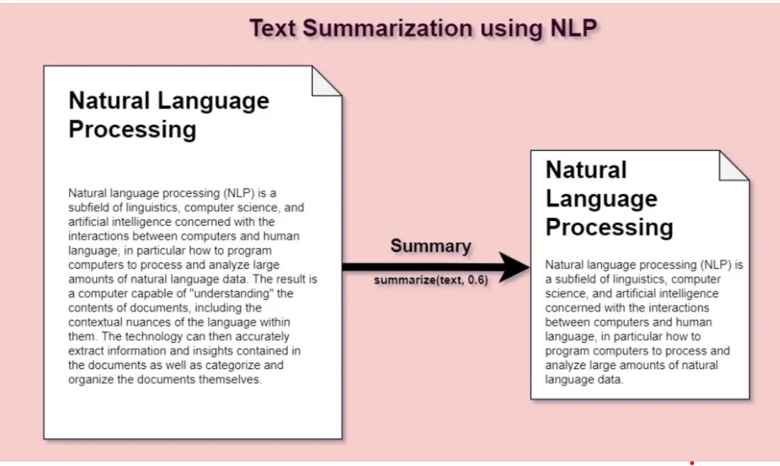
Introduction
Text summarization is a natural language processing (NLP) technique used to automatically generate a shorter version of a long piece of text, while retaining the most important information.
The goal of text summarization is to provide a concise and coherent summary of the original text.
Extractive: Extraction-based methods involve identifying and selecting the most important sentences or phrases from the original text.
Abstractive: Aim to generate a summary by paraphrasing and rephrasing the original text, rather than simply selecting and reordering sentences.
USES:
Time-saving
Improved comprehension
Information retrieval
Note: the choice of summarization type depends on the specific use case and the preferences of the user.

Slide 4
Features of summary
The main idea of the summary is to cut down the document into single or two paragraphs which is going to easily understood by humans.
This summary should have the following features:
Concise: A summary should be brief and to the point, capturing the essential information in the original text.
Coherent: A summary should be logically organized, with ideas presented in a clear and understandable manner.
Accurate: A summary should accurately reflect the main ideas and key points of the original text.
Objective: A summary should be unbiased and free from personal opinions or interpretations.
Readable: A summary should be easy to read and understand, using simple language and avoiding technical jargon.
Relevant: A summary should focus on the most important and relevant information, avoiding irrelevant or extraneous details.
Comprehensive: A summary should cover all the essential elements of the original text, without leaving out important details.

Slide 5
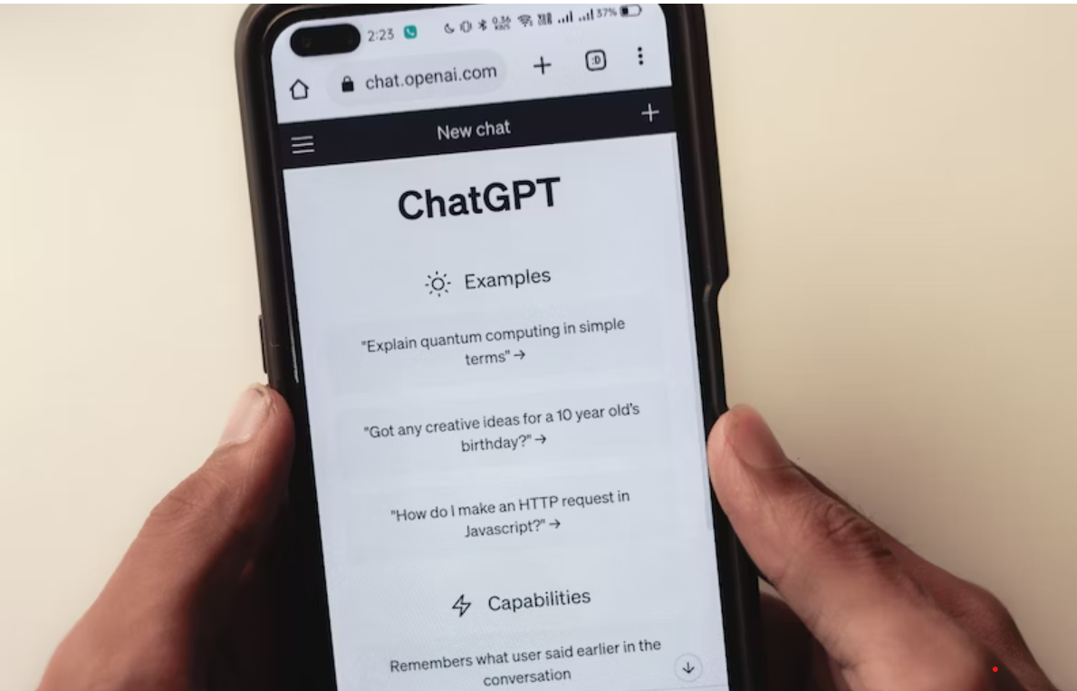
CHATGPT CONTRIBUTION
ChatGPT is one of the most used AI product in recent days in many fields including language processing.
why?
Improved performance
Accessibility
Versatility
Efficiency
ChatGPT provides abstractive summary until we specify the other method.
This summarization covers the entire article and provides a simple summary which is easy to understand.

Slide 6
Any other approaches?
There are several other machine learning models that help in text summarization.
Latent Semantic Analysis (LSA):
This is a statistical model that uses singular value decomposition to identify patterns in the relationships between terms and documents and can be used for summarization.
BERT:
IT is a transformer-based model that uses a bi-directional approach, meaning that it analyzes the context of words both before and after the current word in a sentence. This allows BERT to better understand the relationship between words and their meaning. which leads to more accurate language processing.
XLNet:
XLNet is a transformer-based language model that uses bidirectional context to generate summaries of text. It is pre-trained on large datasets and has achieved state-of-the-art performance on various natural language processing tasks, including text summarization. Unlike other models such as BERT, which uses a left-to-right approach to pre-training, XLNet considers all possible permutations of words in a sequence, effectively allowing it to learn contextual relationships in both directions.

Slide 7
Which one is the best approach?
The main agenda is the provided summary should be easy to understand by human’s and can grasp complete knowledge of the article.
We need to compare many machines learning developed summaries to manual summaries and identify the similarity between them.
this comparison can be done by applying multiple evaluation metrics such as:
ROUGE (Recall-Oriented Understudy for Gisting Evaluation): ROUGE compares the generated summary to reference summary. It measures the overlap between the generated summary and the reference summary in terms of n-gram (i.e., sequence of n words) recall, precision, and F1 score. ROUGE has several variants, such as ROUGE-1, ROUGE-2, and ROUGE-L
BLEU (Bilingual Evaluation Understudy): BLEU is also a metric that compares the generated summary to a reference summary by calculates the n-gram precision of the generated summary against the reference summary and then computes a modified precision score that avoids penalizing short summaries. BLEU scores range from 0 to 1, where a higher score indicates a better summary.
METEOR ,BERT and etc.

Slide 8
Research questions?
We got to know that ChatGPT is the extensively getting used in many industries including the language processing.
We want to answer the following questions:
How accurate are the text summaries produced by ChatGPT?
How does the performance of different machine learning models compare in validating ChatGPT's text summaries?
What is the Use?
This can be helpful in determining the appropriate use cases for ChatGPT and understanding its strengths and limitations.
understanding the performance of different machine learning models can aid in the development and improvement of text summarization techniques and may change our perception towards chatGPT usage.

Slide 9
Previous Literature
Paulus, R., Xiong, C., & Socher, R. (2017) proposes a deep learning model for abstractive text summarization that uses reinforcement learning to improve the quality of the summary. The model is evaluated on the CNN/Daily Mail dataset and outperforms several baseline models in terms of ROUGE scores.
Gehrmann et al. (2018) proposes a bottom-up approach to abstractive summarization, where sub-sentential units are first extracted and then combined to generate a summary. They demonstrate that this approach outperforms previous methods on the CNN/Daily Mail dataset, with human evaluators rating their summaries as more fluent and informative.
Li and Li (2020) proposed a semantic guidance generative pre-trained transformer 2 (SGGPT2) for abstractive text summarization. They utilized a semantic-guided approach to generate more accurate summaries by using a semantic relevance score to guide the selection of words. Their model outperformed several state-of-the-art models on the benchmark dataset.
Huang, Yen, and Yang (2021) proposed a new approach to training text summarization models using curriculum learning. Their method involves training models on increasingly difficult samples to improve the model's performance. They evaluated their method on a standard summarization dataset and found that it outperforms the baselines and achieves state-of-the-art results.

Slide 10
Data Collection
To perform the analysis we need a dataset consist of articles related to different domains like business, entertainment and etc.
Having diversion in data will helps us to compare the chatGPT and another machine learning summaries at different article types and identify how good each model at particular topic.
We got a data set from Kaggle which consist of 4300 articles related to multiple domains and its abstractive manual summaries.
This the primary step in our analysis.
we have added the chatGPT summaries to the dataset manually which was the very crucial step in our analysis.

Slide 11
Data Distribution
From the above we can see that most of the articles are related to News followed by articles related to movies and entertainment. Considerable amount of contribution is given to articles related to politics, crime stories, awareness and sports.
Having different word corpus will better helps in validated the scores very accurately.

Slide 12
Result Analysis
Our main aim is to compare the similarity between chatGPT summary, BERT summary and other machine learning model summaries with the manual summary to conclude which Text summarization is more accurate.
Metric | Value
Average of chatgpt summary - rouge1 | 0.45
Average of BERT summary - rouge1 | 0.44
Average of GPT-2 summary - rouge1 | 0.43
Average of XLNet summary - rouge1 | 0.42
Average of chatgpt summary - rouge2 | 0.41
Average of GPT-2 summary - rouge2 | 0.39
Average of XLNet summary - rouge2 | 0.20
Average of BERT summary - rouge2 | 0.22
Average of chatgpt summary - rougeL | 0.45
Average of BERT summary - rougeL | 0.40
Average of GPT-2 summary - rougeL | 0.31
Average of XLNet summary - rougeL | 0.30
ROUGE score more than 0.4 is considered as good summarization.
So here chatGPT summary and the BERT model summaries are showing the highest similarity with manual summary.
When we shown these two summaries to third person for coherence and content check most of the people spotted both the summaries are good. However, chatGPT summary is more readable.
Overall summarization wise we are concluding the chatGPT is better.

Slide 13
Result Analysis by domain level
We want to understand summarization pattern is similar to all domains?
Domain | ChatGPT | BERT | GPT_2 | XLNet summary
Academics | 0.29 | 0.31 | 0.27 | 0.27
Accident | 0.43 | 0.43 | 0.36 | 0.36
advertisement | 0.16 | 0.13 | 0.14 | 0.14
Awareness | 0.50 | 0.43 | 0.21 | 0.19
Childcare | 0.40 | 0.30 | 0.24 | 0.19
Crime | 0.51 | 0.43 | 0.22 | 0.18
Entertainment | 0.60 | 0.13 | 0.12 | 0.14
Environment | 0.50 | 0.17 | 0.14 | 0.15
Festival | 0.40 | 0.34 | 0.34 | 0.34
Harrasment | 0.65 | 0.40 | 0.25 | 0.22
Investigation | 0.48 | 0.62 | 0.62 | 0.42
Law | 0.27 | 0.40 | 0.35 | 0.29
News | 0.24 | 0.22 | 0.23 | 0.20
Politics | 0.21 | 0.32 | 0.22 | 0.21
Research | 0.50 | 0.51 | 0.11 | 0.11
Sports | 0.54 | 0.43 | 0.16 | 0.16
From the table we can see that academics related articles are better summarized by BERT.
Articles related to advertisement and Law have poor scores in almost all the models as they might have different corpus.
Remaining all other domains more or less chatGPT is best when we compare with ROUGEL score.

Slide 14
Result Analysis by BERT score
our main aim is to compare the similarity between chatGPT summary, BERT summary and other machine learning model summaries with the manual summary to conclude which Text summarization is more accurate.
BERTScore: It is calculated by computing the F1 score of the top k (default: 3) token-level matches between the reference and candidate summaries.
The token-level matches are determined by comparing the cosine similarity between the BERT embeddings of the tokens in the two summaries. The resulting F1 score ranges from 0 (no overlap) to 1 (perfect overlap).
From the table we can see all the models are almost equal for all the machine learning models. However, ChatGPT is little best.
Metrics | Value
Average of chatgpt summary BERTScore | 0.895468
Average of BERT summary BERTScore | 0.883063
Average of GPT-2 summary BERTScore | 0.881706
Average of XLNet summary BERTScore | 0.877955

Slide 15
Result Analysis by BERT at Domain
Domain | ChatGPT | BERT | GPT2 | XLNet
Academics | 0.91 | 0.90 | 0.89 | 0.89
Accident | 0.93 | 0.93 | 0.91 | 0.91
advertisement | 0.86 | 0.86 | 0.85 | 0.87
Awareness | 0.90 | 0.88 | 0.88 | 0.87
Childcare | 0.91 | 0.89 | 0.89 | 0.90
Crime | 0.89 | 0.89 | 0.88 | 0.88
Entertainment | 0.88 | 0.86 | 0.86 | 0.86
Environment | 0.89 | 0.88 | 0.88 | 0.88
Festival | 0.89 | 0.91 | 0.89 | 0.91
Harrasment | 0.90 | 0.89 | 0.89 | 0.88
Investigation | 0.95 | 0.94 | 0.94 | 0.92
Law | 0.91 | 0.90 | 0.91 | 0.90
News | 0.90 | 0.89 | 0.89 | 0.88
Politics | 0.89 | 0.88 | 0.88 | 0.88
Research | 0.88 | 0.87 | 0.86 | 0.86
Sports | 0.89 | 0.87 | 0.87 | 0.87
BERT score is almost like all the models at each domain which means that the summary provided by all these models are highly semantically similar to manual summary.
Here also chatGPT is comparatively better with other machine learning models.

Slide 16
Conclusion
From the results analysis it is clearly evident that ChatGPT summarization is accurate, easy to read and understand .
However there are some domains articles like Law, Advertisement are having comparatively low similarity with article because these articles might have different word corpus.
Both the Evaluation metrics highly important to identify the similarity ROUGE will helps in words comparison and BERT will helps us to understand the schematics.
GITHUBLINK:
https://github.com/Devendarreddybathini/Devendarreddy_INFO5731_spring2023/upload/main/Project

Slide 17
Author Contribution
Name | Contribution
Sangeetha | Background and Literature Review, identify the MLs to generate the summaries and report writing.
Nitisha | Background and Literature Review, identify the MLs to generate the summaries and report writing.
Ajay | Data identification & preparation, report writing.
Ashwitha | Data preparation, methodology creation, PPT creation and report writing.
Devendarreddy | Implementation of Machine learning models and apply the metrics to conclude the results. Helped in PPT creation and report writing.

